Slide 1
FFT Audio Visualizer
Rehan Iqbal
Yogesh Dhada
Meng Lei

Slide 2
Block Diagram
Audio Input (Nexys4 Microphone)
audio demo
FFT
Image Control
VGA Display
Picoblaze
Nexys4_RGB_if
DTG
pushbuttons

Slide 3
Audio_demo
Dedicated ADC on Nexys4DDR board samples at 3MHz
Provides PDM output of sample

Slide 4
Audio_demo: main I/O
.clk_i
.pdm_clk_o
.clk_6_144MHz
.data_mic_valid
.pdm_data_i
.data_mic
.pdm_lrsel_o
pdm_filter

Slide 5
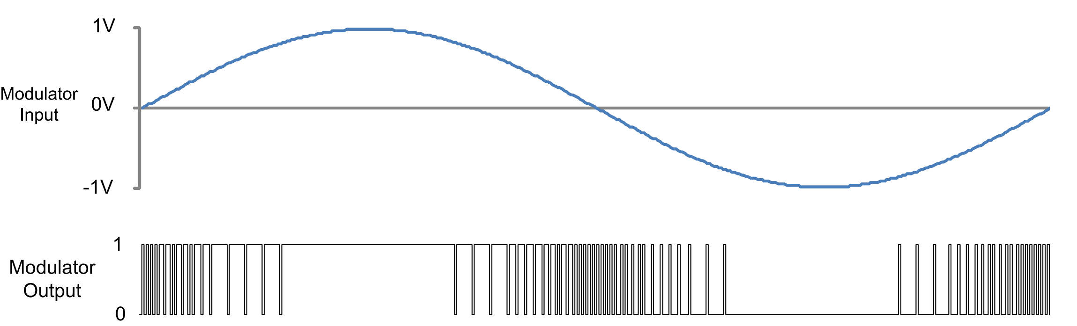
Pulse Density Modulation
Increasing number of 1’s as signal amplitude increases

Slide 6
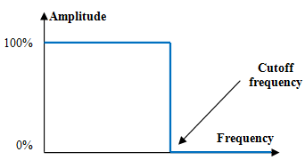
PDM Filter
Noise Problem:
Crappy mic
4 filter stages
CIC Filter
Highband filter
Lowpass filter
Highpass filter
Low-pass FIR filter
Notes:
CIC works 192Khz
Second stage: Halfband filter with decimation ratio of 2 and input -- sampling frequency of 192 kHz, resulting in a 96 kHz output sample rate.
Low pass filter: sampling rate 96KHz
HighPass 96KHz removing DC component

Slide 7
pdm_filter: main I/O
.clk_i
.pdm_clk_o
.clk_6_144MHz
.fs_o
.pdm_data_i
.data_o
CIC filter
halfband filter
lowpass filter
highpass filter

Slide 8
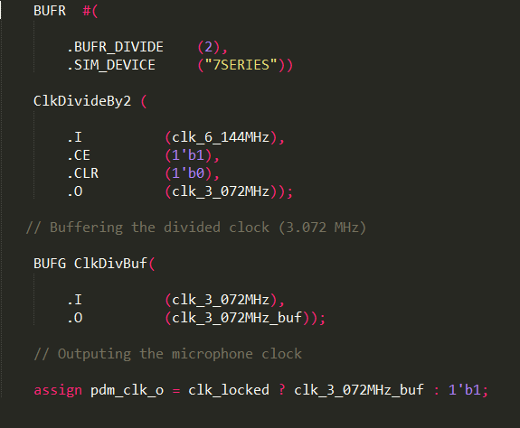
Dividing the 6.144MHz clock for 3.072MHz

Slide 9
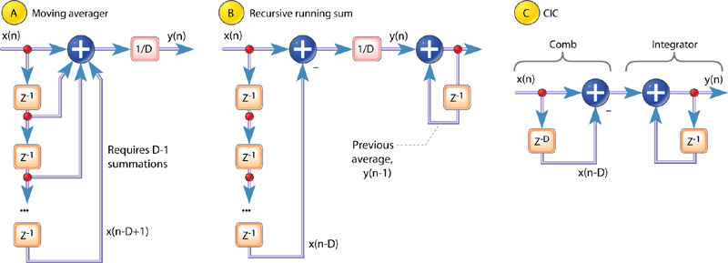
CIC Filter:
A twist on the recursive running-sum filter
Which is a twist on the moving average

Slide 10
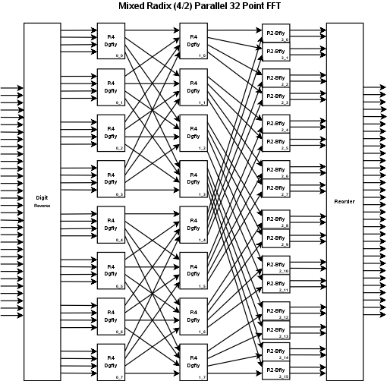
Fast Fourier Transform
Use Cooley–Tukey FFT algorithm to split Discrete Fourier Transform into multiple smaller DFT’s
This reduces operation order from O (n ^ 2) to O( n * log n )
Multiple forms: different radices, butterfly options, etc.
Lends itself to parallel computation

Slide 11
First attempt: use HLS to implement
Multiple high-level synthesis (HLS) tools available:
System Generator: design and simulate using Simulink blocks specifically made for Vivado
HDL Coder: write MATLAB code or design Simulink and convert to HDL
Vivado HLS: write C code and convert to HDL
Issues: Need to compare generated HDL against original model
Fixed point conversion issues
Checking whether it’s accurate enough
Simulation speed (co-simulate on board possible)
Just getting familiar with workflow is hard

Slide 12
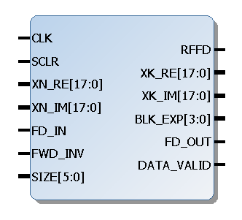
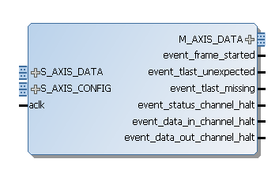
Two Vivado IP cores available
Discrete Fourier Transform
Fast Fourier Transform

Slide 13
ImgControl
Similar to icon.v from Project 2
Store FFT output in a block RAM
As pixel goes across screen, read memory to find FFT power reading for that bin
Based on vertical position and power, determine whether to draw or not

